Slide 1

RES 500 Academic Writing and Research Skills
Week 7
Research Planning and Research Process

Slide 2
Research Planning and Research Process
Research Planning
Research Process
Further Readings, Keywords, References

Slide 3
Research Planning and Process → Learning Objectives
Understand . . .
The main steps in conducting research.
Research is decision- and dilemma- centered.
The clarified research question is the result of careful exploration and analysis and sets the direction for the research project.
What is included in research design, data collection, and data analysis.
Research process problems to avoid.

Slide 4
Research Planning
Research Planning Involves the following steps:
Selecting a topic
The purpose of the study
Hypothesis, objectives and research question
Working title and project outline
Timing
Supervision
Write as you go

Slide 5
Research Planning → Selecting a topic
Do not select a topic before doing ground work.
Select a topic of interest, hopefully with practical applications.
Why we do research:
  We need to do research to know more and to act better than we did before (add to the sum of knowledge).
Whatever the size of the study (undergraduate project or a Ph.D. Thesis), you are required to analyze and evaluate the collected information and suggest desirable changes.

Slide 6
Research Planning → Selecting a topic
You may be given a topic to research or select from a list of topics or select a topic yourself.
Write down available ideas.
Think about each topic:
  What it might involve?
  Will it be likely to maintain my interest? If you get bored, the time will go and the research will lack the quality.
Talk to colleagues about the topics, they may be aware of sensitive aspects about the topics which could cause difficulties. They may direct you to people who have done something similar.

Slide 7
Research Planning → Selecting a topic
Bring the list down to two or three.
Write ideas, questions and doubts about your first choice and what you can do. Word ordering is not important at this stage.
This will give clues whether this topic is too complex to complete within the timescale or you need access to confidential or unavailable data.
Do the same for other ideas.
Refine the summary with improved ideas, remove overlapping, and state research questions.

Slide 8
Research Planning → Purpose of study
Decide why you want to carry out this research.
Has any research been done in this area?
Need to obtain any permissions?
Study the literature to see what has been done in this topic.
This is the what stage. What you are doing?

Slide 9
Research Planning → Purpose of study
The value of research may be judged in terms of the difference between the result of decisions made with the information and the result that would be made without it.
Option analysis: Analysis of each alternative research project in terms of estimated costs and associated benefits.
Decision theory: Assess the outcomes of each action. Choose the action that meets or exceeds whatever criteria are established.
Prior (Interim) Evaluation: Doing a study in stages. Costs are then reviewed at each stage.
Ex Post Facto Evaluation: This form occurs after the research is conducted but can be useful in guiding future decisions.

Slide 10
Research Planning → Hypothesis, objectives and research question
Hypothesis is a proposition that needs to be verified through subsequent investigation.
Hypothesis provide guide to the researcher on how the original ideas may be tested.
The results of the research will either support or not support the hypothesis.
Large projects require statistical testing.
A precise list of objectives and research questions is needed. This list may be modified later.

Slide 11
Research Planning → Working title and project outline
Select a temporary, meaningful working title.
Produce the project outline.
Think more about;
  Purpose of the study
  Focus (Scope) of the study
  Identify your sample and required permissions.
  What information I need to answer my questions?
  How to get such information
  The submission date and timing of your project
Discuss the project outline with your supervisor.

Slide 12
Research Planning → Timing
You need to complete within a specified time.
There is a high probability of falling behind the schedule.
Check your progress periodically.
Reading is one of the reasons of falling behind. At some stage, you have to stop reading and start writing.
Consult your supervisor before falling much behind.
Project plan is modifiable.

Slide 13
Research Planning → Supervision
It is extremely important to have a good relation with your supervisor.
Alone you can rarely produce a quality research.
We need a supervisor in whom we have confidence, we can share thinking, willing to advise and give honest view.
A balance is needed to accommodate the supervisor’s other commitments.
A code of practice for supervision is adopted in many universities.
Sometimes change of supervisor is the solution.
Keep a record of research meetings. A form is adopted in many universities. Date, discussed issues, goals, summary and next meeting.

Slide 14
Research Planning → Write as you go
Writing should be ongoing.
Summarize your references
Remember you need to avoid Plagiarism. Remember ways of doing so.

Slide 15
Research Process
Research Process Involves the following stages:
Stage 1: Clarifying the Research Question
Stage 2: Proposing Research
Stage 3: Designing the Research
Stage 4: Data Collection & Preparation
Stage 5: Data Analysis & Interpretation
Stage 6: Reporting the Results
Problems to Avoid

Slide 16
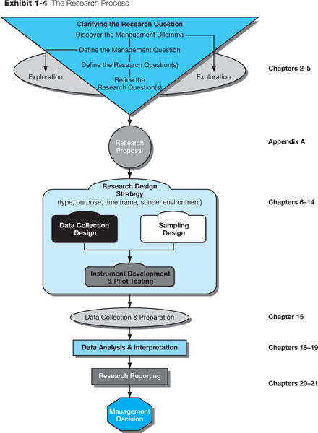
Research Process
Stage 1: Clarifying the Research Question
Stage 2: Proposing Research
Stage 3: Designing the Research
Stage 4: Data Collection & Preparation
Stage 5: Data Analysis & Interpretation
Stage 6: Reporting the Results

Slide 17
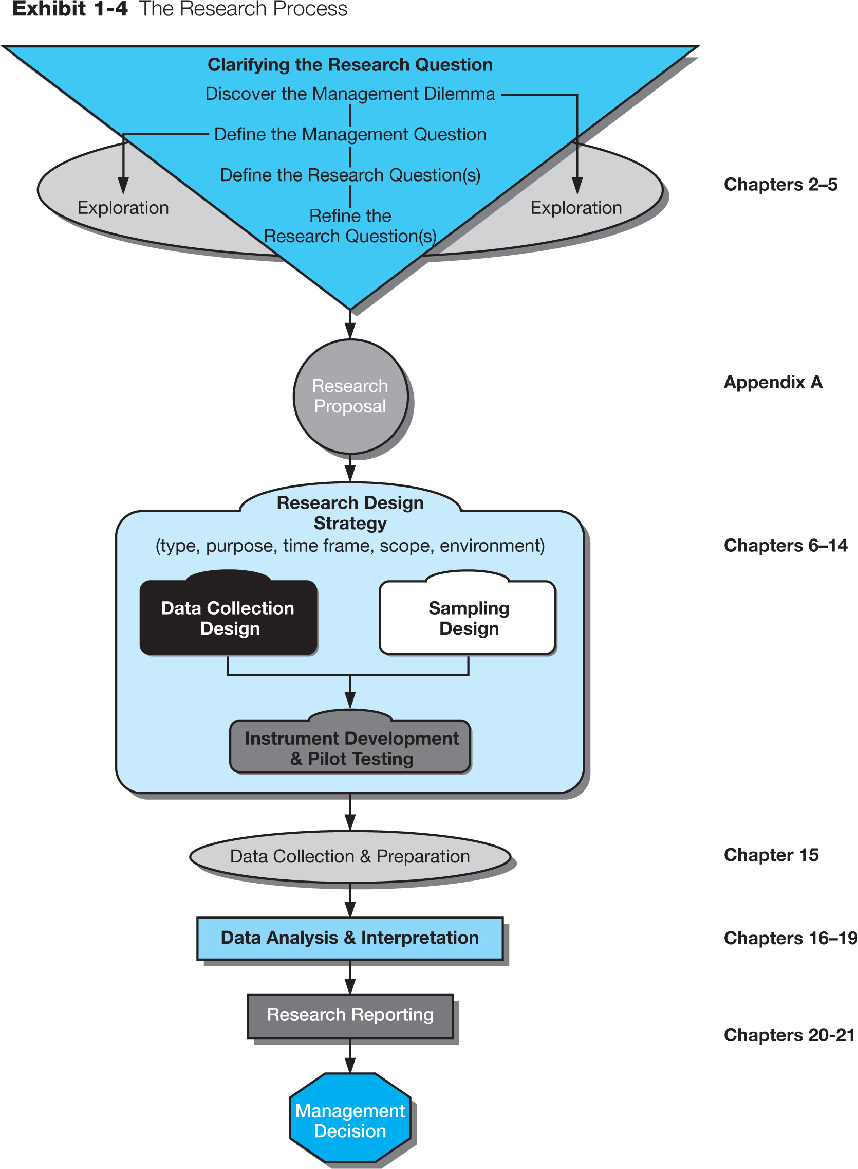
Research Process → Stage 1: Clarifying the Research Question
Notes:
This slide focuses on stage 1 of the research process, clarifying the research question.
A useful way to approach the research process is to state the basic dilemma that prompts the research and then try to develop other questions by progressively breaking down the original question into more specific ones. This process can be thought of as the management-research question hierarchy.
The process begins at the most general level with the management dilemma. This is usually a symptom of an actual problem, such as rising costs, declining sales, or a large number of defects.
Key terms:
A management dilemma is an opportunity of problem that has been discovered because of one or more symptoms.
A management question is a restatement of the manager’s dilemma in question form.
A research question is the hypothesis that best states the objective of the research; the question that focuses the researcher’s attention.
An investigative question is the question the researcher must answer to satisfactorily answer the research question.
A measurement question is the question asked of the participant or the observations that must be recorded.

Slide 18
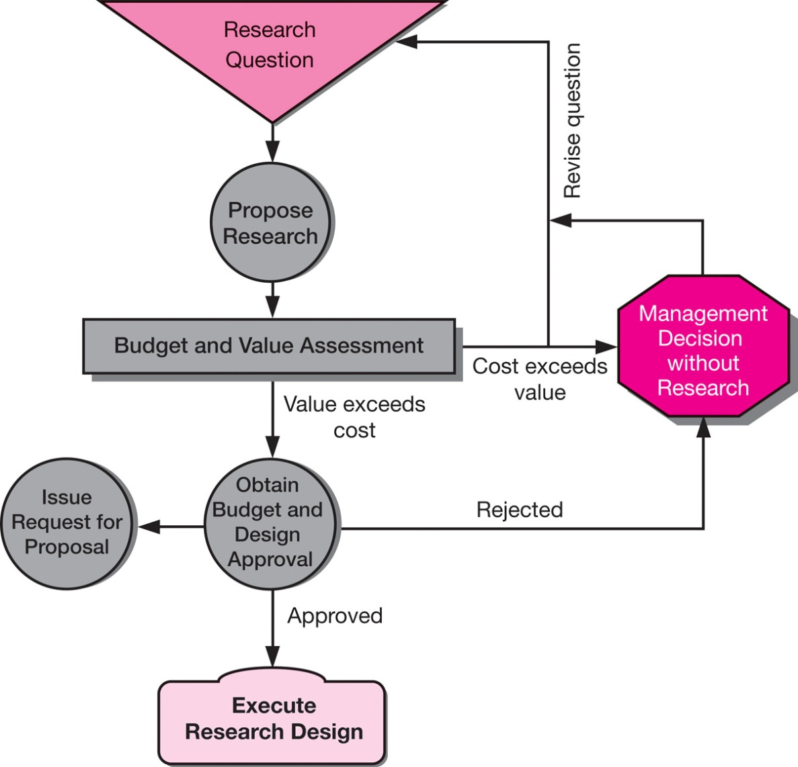
Research Process → Stage 2: Proposing Research
Notes:
From Appendix A.
Once the research is defined, the research must be proposed in order to allocate resources to the project. There are three types of budgets in organizations where research is purchased and cost containment is crucial.
Rule-of-thumb budgeting involves taking a fixed percentage of some criterion. For example, a percentage of the prior year’s sales revenues may be the basis for determining the business research budget for a manufacturer.
Departmental (functional area) budgeting allocates a portion of total expenditures in the unit to research activities. This allows units like human resources and marketing to have the authority to approve their own projects
Task budgeting selects specific research projects to support on an ad hoc basis. This is the least pro-active form but permits definitive cost-benefit analysis.

Slide 19
Research Process → Stage 2: Proposing Research → Elements of a research proposal:
Purpose
Methods
Extent
Legally-binding
contract
Timing
Written
proposals
establish
Obligations
Delivery
Budgets

Slide 20
Research Process → Stage 3: Designing the Research

Slide 21
Research Process → Stage 3: Designing the Research → Components of the research design
Components to research design stage:
  Research design: blueprint for fulfilling objectives and providing the insight to answer the management dilemma. There are many methods, techniques, procedures, and protocols possible.
  Sample Design: Identify the target population and determine whether a sample or census is desired. A census is a count of all elements in a population. A sample is a group of cases, participants, events, or records that constitute a portion of the target population. The researcher must determine whether to choose a probability or nonprobability sample.
  Pilot testing: is conducted to test weaknesses in the research methodology and the data collection instrument and to provide proxy data for selection of a probability sample.

Slide 22
Research Process → Stage 4: Data Collection & Preparation
Data may be characterized by their abstractness, verifiability, elusiveness, and closeness to the phenomenon. As abstractions, data are more metaphorical than real. e.g. the growth in GDP cannot be readily observed.
Second, data are processed by our senses. When sensory experiences consistently produce the same result, our data are said to be trustworthy.
Capturing data is elusive.
    Secondary data are originally collected to address a problem other than the one which require the manager’s attention at the moment.
    Primary data are data the researcher collects to address the specific problem at hand.

Slide 23
Research Process → Stage 5: Data Analysis & Interpretation
Steps:
Reduce data to manageable size
Develop summaries
Look for patterns
Apply statistical techniques

Slide 24
Research Process → Stage 6: Reporting the Results
In reporting the results, the researcher should strive to provide insightful information adapted to the client’s needs and to choose words carefully when crafting interpretations, conclusions, and recommendations.
The research report should include the following parts:
  Executive summary: consists of a synopsis of the problem, findings, and recommendations.
  Research overview: explains the background, exploratory findings from secondary data, the research design and procedures, and the conclusions.
  Implementation strategies: expands on recommendations.
  Technical appendix: contains all the materials necessary to replicate the project.

Slide 25
Research Process → Stage 6: Reporting the Results
Components of Research report overview
Problem’s background
Summary of exploratory findings
Research design and procedures
Conclusions

Slide 26
Research Process → Problems to Avoid
Researchers must remain objective. Some common problems in the research process.
Unresearchable questions: Not all questions are researchable and not all research questions are answerable.
ill-defined problem: is one that addresses complex issues and cannot be expressed easily or completely.
Politically-Motivated Research: Sometimes a research study is intended to win approval for a pet idea or to protect a decision maker. In these cases, it may be more difficult to get support for the most appropriate research design.

Slide 27
Research Process → Problems to Avoid
The favored-technique syndrome occurs when researchers are method-bound. They recast research questions so that it is amenable to their favorite method.
Company database strip-mining managers may feel that they do not want to collect more data until they have thoroughly evaluated all existing data. While data mining can be a good starting point, it will rarely address all questions related to a specific management dilemma.

Slide 28
Research Ethics → Further Reading
Planning the project checklist [2, PP. 40-42]

Slide 29
Research Ethics → Key Terms
Census
Data
  Primary data
  Secondary data
Data analysis
Decision rule
exploration
Investigative questions
Management dilemma
Management question
Management-research question hierarchy
Pilot test
Research design
Research process
Research questions
Sample
Target population

Slide 30
References
Business Research Methods by Donald R Cooper, 12th Edition.
  Chapter 4 - The Research Process An Overview, PP 74-91
Doing Your Research Project: A Guide for First-Time Researchers in Education, Health and Social Science, 5th Edition
  Chapter 2 - Planning the Project, PP 27-43

